Slide 1








Money: Notes and Coins
2022-1-BG01-KA220-SCH-000085065

Slide 2
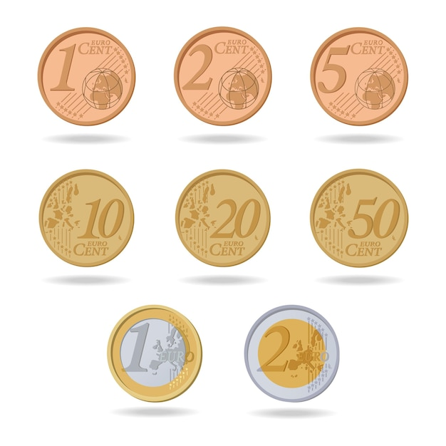

Slide 5
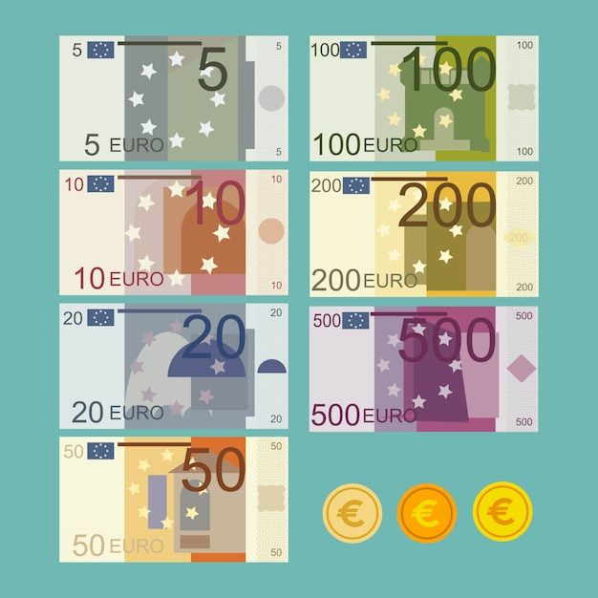


Slide 12
2022-1-BG01-KA220-SCH-000085065
Subject: Maths
Age of students: 9 – 10 years old
Topic: Numbers and Operations
Resource Title: Solving problems using money
Credits: AECE – Escola Básica da Zona Verde
All media are within the EU intellectual property law.
The European Commission’s support for this publication does not constitute an endorsement of the contents, which reflect the views only of the authors, and the Commission cannot be held responsible for any use which may be made of the information contained herein.

